Slide 1
Hand Gesture Recognition via Webcam Using CNNs
Khalid Brelvi, Lucas Connell

Slide 2
Introduction / Motivation

Slide 3
CNN’s
CNN’s are widely used for image classification tasks due their feature extraction capabilities and simple design process
The question: How can CNN’s be applied to a hand gesture recognition task using a webcam
2 approaches:
Create and optimize a custom CNN (Approach 1: Khalid)
Use a pre-trained model and tailor it to perform our task (Approach 2: Lucas)

Slide 4
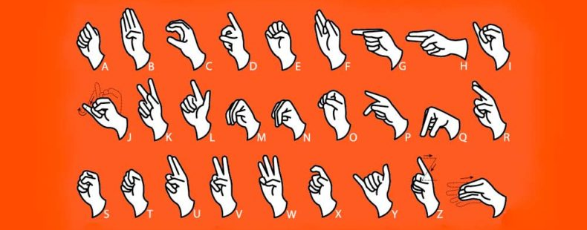
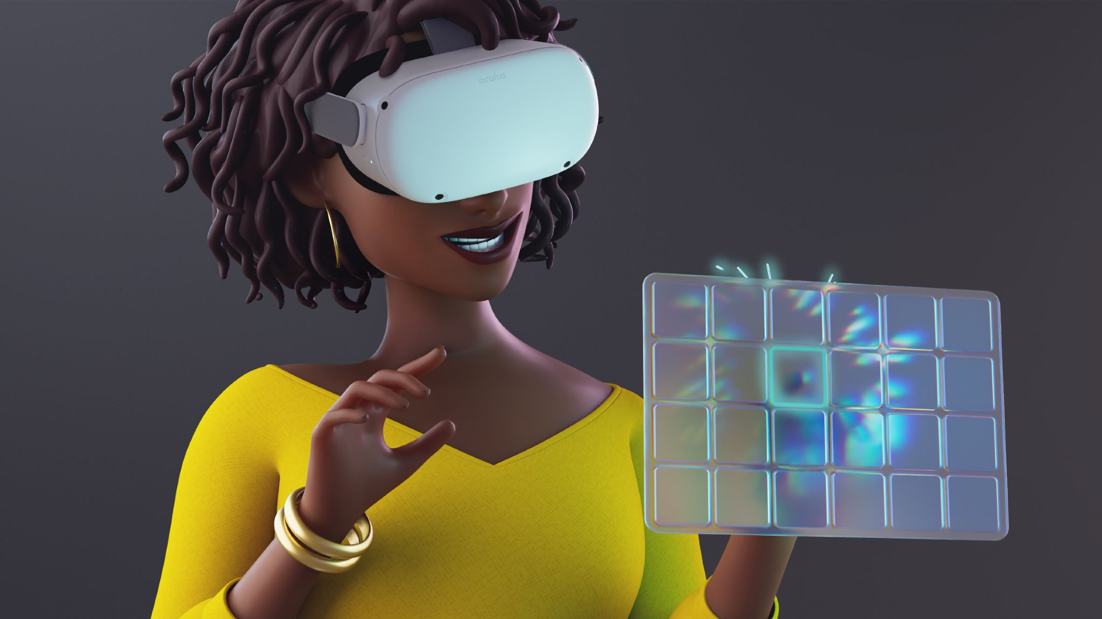
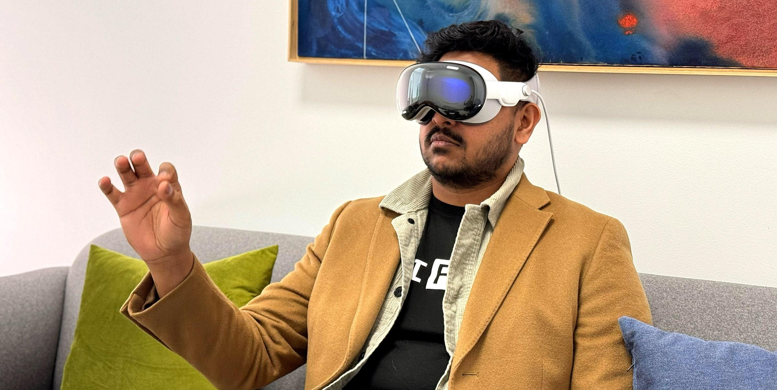
Applications
Sign language recognition
Entertainment
New form of interface
Notes:
Image sources top to bottom:
https://www.dictionary.com/e/american-sign-language/
https://about.fb.com/news/2023/02/meta-quest-direct-touch-use-your-fingers-in-vr/
https://www.wired.com/story/apple-vision-pro-hands-on-january-2024/

Slide 5
Approach 1: Building a Custom ReLU CNN

Slide 6
Approach 1: Design + Implementation

Slide 7

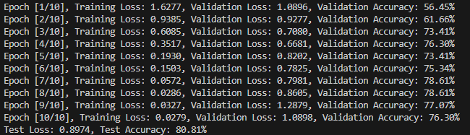
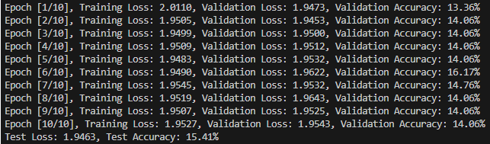
Why ReLU?
Lower latency on live feed
Better results during testing
Standard in other similar CNNs
ReLU
Sigmoid
Notes:
Source: https://towardsdatascience.com/activation-functions-neural-networks-1cbd9f8d91d6

Slide 8
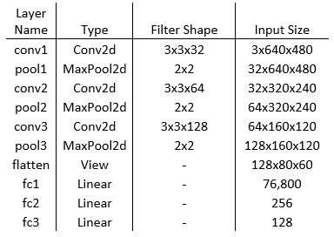
Custom Architecture
3 convolution layers
Should probably be larger
7 output nodes
Thumbs-up/down, numbers 1-5

Slide 9
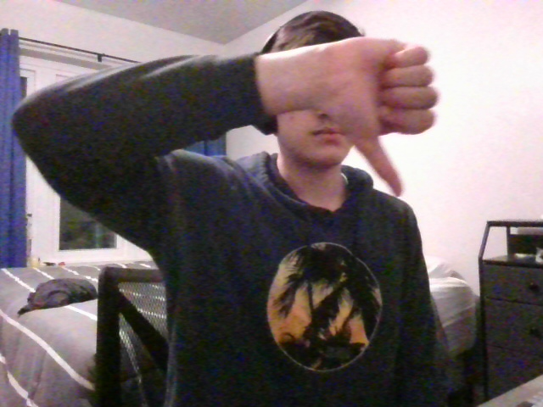
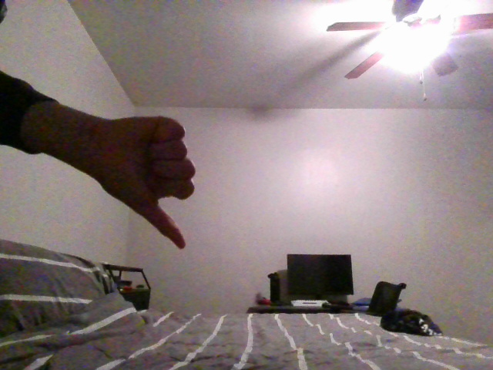
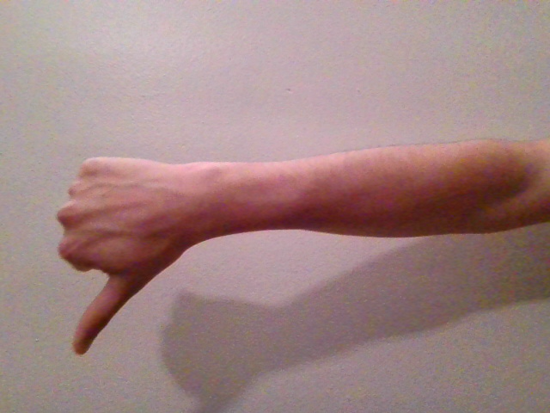
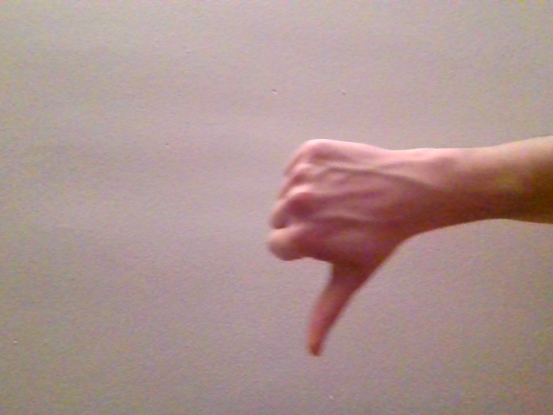
Dataset Creation
Originally tried to collect images in a variety of locations and lightings
Re-gathered dataset reducing variance
Images resized, converted to Tensor, then normalized similarly to ImageNet
Notes:
Normalizing: normalized_value = (original_value - mean) / std
Source: https://pytorch.org/vision/stable/models.html

Slide 10
Optimization, Loss, and Training
Adam Optimizer, Cross Entropy Loss
Training: 75/15/15 Training / Validation / Test Split
3500 Images, 500 of each category
Trained with 10 Epochs
Total training time around 1.5 hours

Slide 11
Approach 1: Results

Slide 12
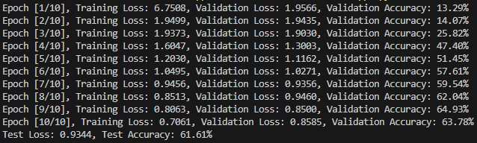
Training and Validation Results

Slide 13
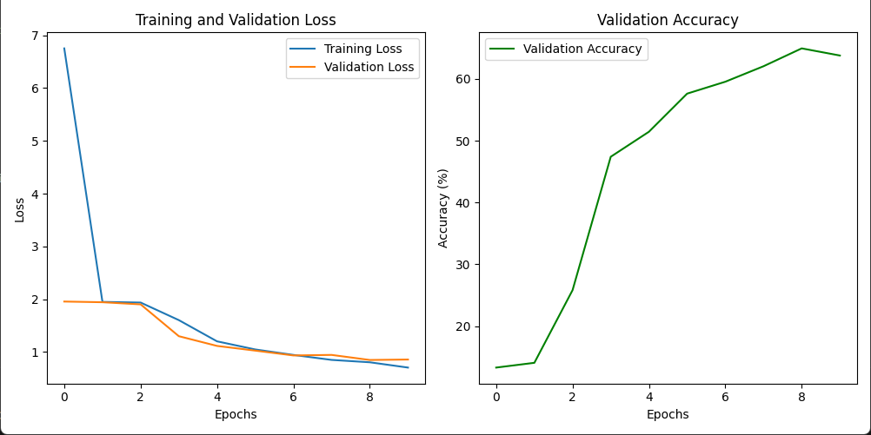
Training and Validation Results

Slide 14
Demo

Slide 15
Approach 1: Challenges

Slide 16
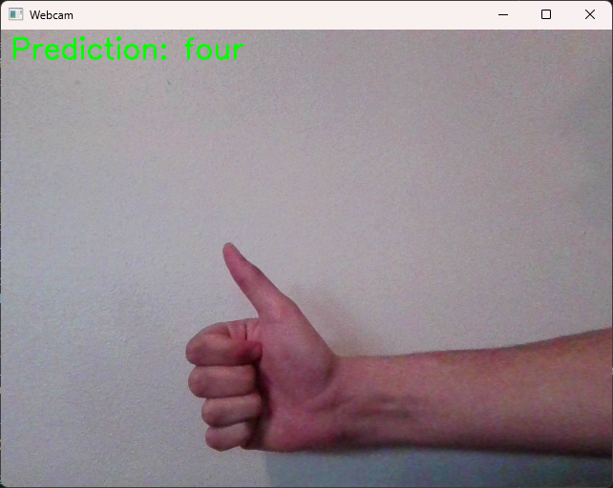
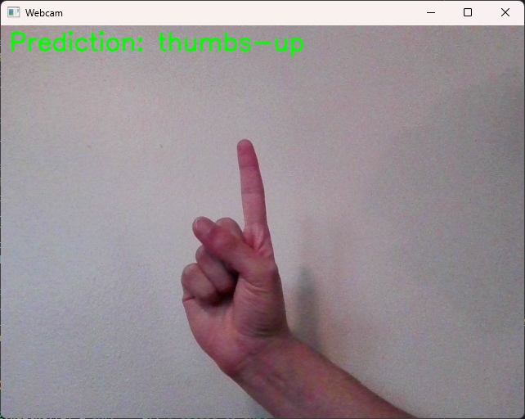
Hurdles
It is not very good
Test accuracy > 60%
Does not function well under the same conditions that the dataset was acquired
Computational resources
Re-training the CNN takes ~1.5 hrs
Uses 80% of available memory, rendering computer otherwise unusable
Things that worked well:
Seamless live feed integration
CNN trains quickly for running on local machine

Slide 17
Approach 2: Transfer Learning via MobileNetV2

Slide 18
Approach 2: State of the Art

Slide 19
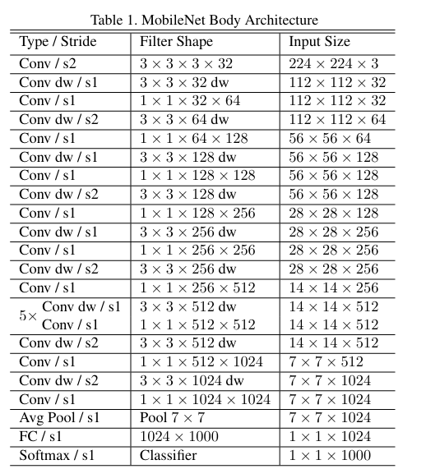
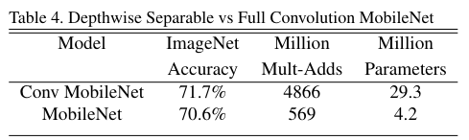
MobileNet and ImageNet
Why reinvent the wheel?
MobileNet is an efficient, lightweight architecture for object detection/recognition tasks:
4.2m parameters, 14 hidden CNN layers
Uses depth-wise separable convolutions to reduce compute cost
[1]
Notes:
Citation: https://arxiv.org/abs/1704.04861

Slide 20
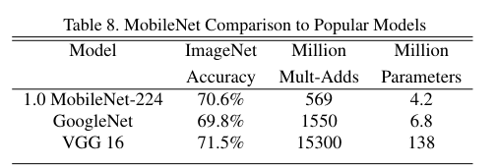
Mobilenet vs Others
MobileNet is more accurate AND more efficient than other common CNN architectures
[1]
Notes:
Citation: https://arxiv.org/abs/1704.04861

Slide 21
ImageNet
MobileNet is trained on the ImageNet dataset:
Considered the forefront dataset for image classification models
Based on WordNet, a compilation of nouns and phrases (~80,000) nouns
IlSVRC has 1000 object classes with over 1m images (most common subset)
We cannot recreate this level of ‘expertise’ in a model easily
Enter: Transfer Learning
[2][3]
Notes:
https://image-net.org/about
https://www.image-net.org/download.php#:~:text=This%20dataset%20spans%201000%20object,images%20and%20100%2C000%20test%20images.

Slide 22
Transfer Learning
MobileNet is already trained on ~1000 categories which makes it excellent at object detection
By ‘freezing’ the hidden layers of MobileNet, and adapting the output layer to accomplish our own task, we can ‘transfer’ MobileNet’s knowledge to perform a new task
[4]
Notes:
https://pythontutorials.eu/deep-learning/transfer-learning/

Slide 23
Approach 2: Design + Implementation

Slide 24
Customizing MobileNet Architecture
7 Gestures = 7 output layers
Thumbs up / thumbs down, numbers 1 - 5
Done with the following piece of code:
(yes, that’s it!)
model_output = Dense(7, activation = 'softmax')
model_output = model_output(model.layers[-2].output)
1 x 1 x 7

Slide 25
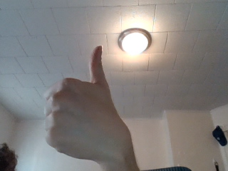
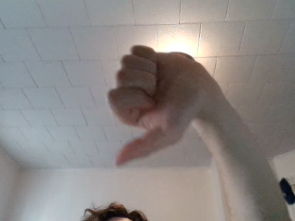
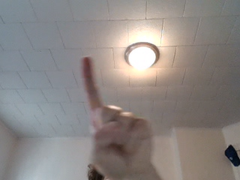
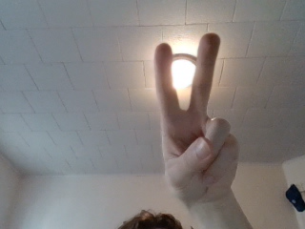
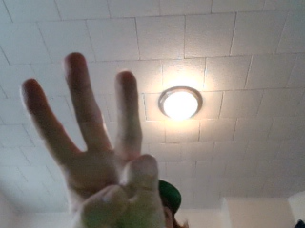
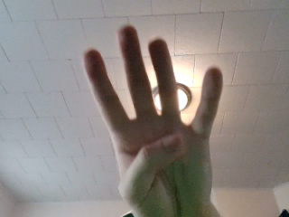
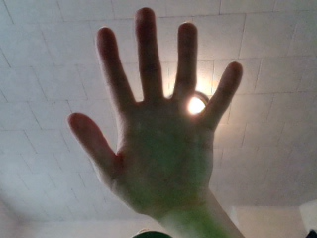
Data Creation + Processing
Khalid created a simple image capturing script to save images into directories
Created integer labels for each category
Randomly shuffled data + labels then split
Preprocessed images into 224x224x3 images with pixel values in range [0,1] (required input to MobileNet model)
Saved processed images into a directory, so it doesn’t have to be redone every time we run the model

Slide 26
Optimization, Loss, and Training
Adam Optimizer, Cross Entropy Loss
Training: 75/25 Training / Validation Split
3500 Images, 500 of each category
Trained with 50 Epochs
Total training time around 4 minutes

Slide 27
Approach 2: Results

Slide 28
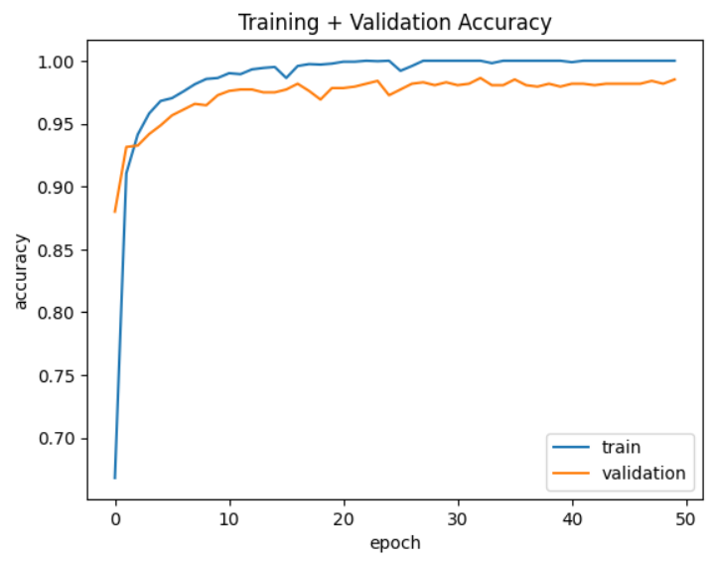
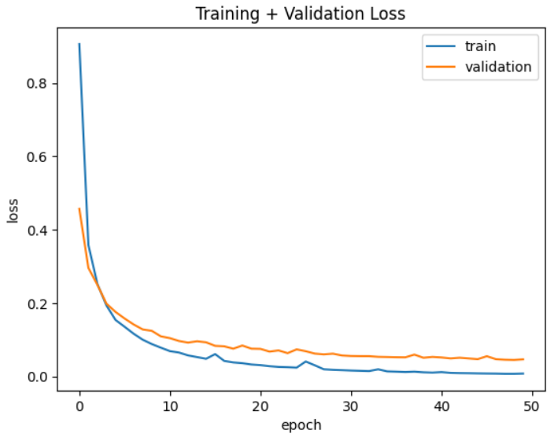
Training and Validation Results

Slide 29
Demo

Slide 30
Approach 2: Challenges

Slide 31
Hurdles
Computational power
Preprocessing image dataset required > 12 GB RAM on Colab (not feasible on personal machine)
Building a robust dataset
Not entirely accomplished - 3500 images takes > 2 hours to upload into Drive
Data management
Data types and array sizes are always finicky
Things that worked well:
Colab VM GPU access
Consulting Keras documentation
Used Colab premade code snippet to capture images
Online tutorials for code basis

Slide 32
Summary
The simple approach of using MobileNet as a basis for transfer learning proved to be effective
A simple ReLU CNN can be effective at gesture recognition under the right circumstances
The one shown today would require more depth to achieve this goal
CNN’s are an effective tool for object recognition tasks
Hand gesture recognition is more difficult than expected

Slide 33
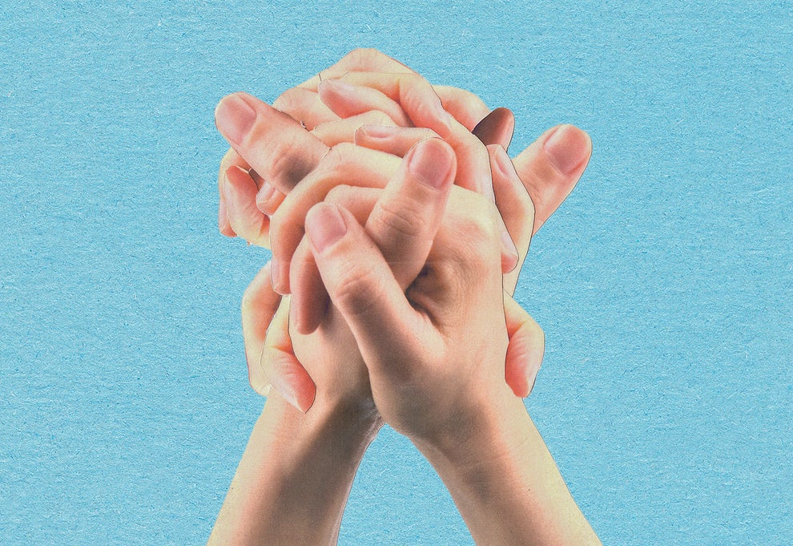
Future Work / Next Steps
There is a need for a more robust universal dataset for hand gestures
We all know how AI handles hands, even transformers…
Configure live image capture (approach 2)
Computationally intensive and difficult on Colab
More complex architecture (approach 1)
Could train model on Colab then run video feed locally
Image from Buzzfeed [5]
Notes:
https://www.buzzfeednews.com/article/pranavdixit/ai-generated-art-hands-fingers-messed-up

Slide 34
References

Slide 35
Approach 1 References
1. Writing custom datasets, DataLoaders and transforms. (n.d.). Writing Custom Datasets, DataLoaders and Transforms - PyTorch Tutorials 2.3.0+cu121 documentation. Retrieved April 23, 2024, from https://pytorch.org/tutorials/beginner/data_loading_tutorial.html
2. Sharma, S. (2022, November 20). Activation functions in neural networks. Medium. Towards Data Science. Retrieved April 23, 2024, from https://towardsdatascience.com/activation-functions-neural-networks-1cbd9f8d91d6
3. Models and pre-trained weights. (n.d.). Models and pre-trained weights - Torchvision 0.17 documentation. Retrieved April 23, 2024, from https://pytorch.org/vision/stable/models.html
‌

Slide 36
Approach 2 References
[1] A. G. Howard et al., “MobileNets: Efficient Convolutional Neural Networks for Mobile Vision Applications,” arXiv.org, 2017. https://arxiv.org/abs/1704.04861
[2] “ImageNet,” Image-net.org, 2020. https://image-net.org/about (accessed Apr. 23, 2024).
[3] “ImageNet,” www.image-net.org, 2020. https://www.image-net.org/download.php#:~:text=This%20dataset%20spans%201000%20object (accessed Apr. 23, 2024).
[4] S. Mathôt , “Customizing MobileNetV2 through Transfer Learning,” Python Tutorials, 2018. https://pythontutorials.eu/deep-learning/transfer-learning/ (accessed Apr. 23, 2024).
[5] P. Dixit, “AI Image Generators Keep Messing Up Hands. Here’s Why.,” BuzzFeed News, Jan. 31, 2023. https://www.buzzfeednews.com/article/pranavdixit/ai-generated-art-hands-fingers-messed-up
‌
‌

